Slide 1
First Nations’ peoples’ knowledge and exploitation of levers

Slide 2
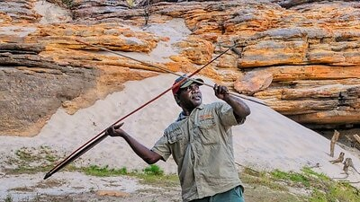
The Woomera
The woomera is uniquely Aboriginal invention that uses leverage to allow a spear to be thrown up to three times further.
Witnesses report seeing spears thrown with enough force to skewer the trunk of a full-grown eucalyptus tree!
Typically, the woomera was made by shaping a piece of hardwood into a long, thin handle and attaching a stone to the base to hold a spear-end in place.

Slide 3
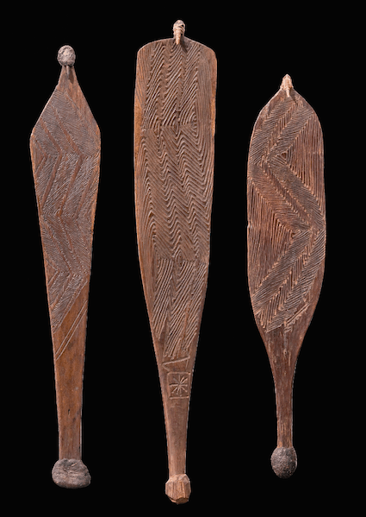
How is a Woomera made?
Crafted out of hardwood, such as mulga, and range in length from approx. 50 to 100cm.
Spear-thrower design, including its dimensions, was carefully refined and optimised for each individual user and carefully matched to the projectile type used.
They have a variety of shapes and widths, but typically they taper towards the gripping end and have notches coated in resin cut on either side at one end to form a hand grip.
The other end is narrow and has a ‘peg’ that is designed to fit into a socket or notch at the base of the spear.

Slide 4
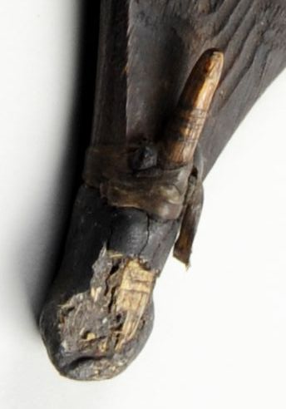
How is a Woomera made?
More technically called a dart. The ‘peg’ can be either integrated into the structure or made from an animal’s tooth or claw and attached by sinew and resin.
Spears up to three metres in length rest on a spear-thrower and are gripped by the spear-throwing hand.
The ‘peg’ is crucial in transmitting force to the spear allowing it to be propelled at a higher velocity than can be achieved by hand alone.
The ‘peg’ also focuses the propelling force enhancing the accuracy of the throw.

Slide 5
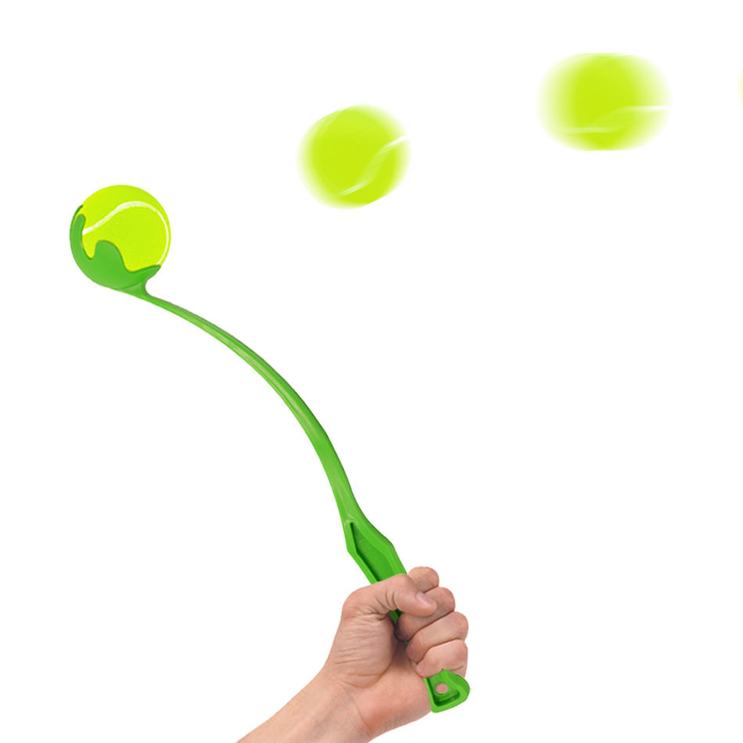
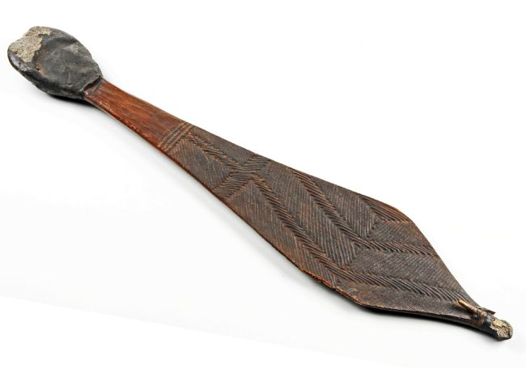
The Physics of a Woomera
The spear thrower (also called a woomera) is used with a spear. It acts as a lever to project the spear with force and speed. This enabled the thrower to increase the spear’s trajectory over a longer distance than could be done by human hand alone.
A spike at the end of the thrower held the spear in place behind the thrower’s head thus extending their reach, just like the gadget that dog walkers use when they throw a ball for their dog.

Slide 6
The details of how it works
Throwing a spear using a spear-thrower involves a complex interaction and co-ordination of the thrower’s skeleton and muscles. Since the spear-throwing process involves a series of levers, defining which class of lever applies is often debated.
When viewing the system of spear-thrower and spear in isolation, it can be classified as a second-class lever, where the fulcrum as well as the load are situated at the peg.
When including the arm and wrist action, a spear-thrower can be classified as a first-order lever which positions the fulcrum between the effort arm and the load arm.
The effort force exerted by the thrower’s hand pivots around the wrist, acting as the fulcrum to move the spear positioned at the longer end of the thrower. The distance from the wrist to the shorter (proximal) end of the spear-thrower is very much smaller than the distance from the wrist to the other (distal) end of the thrower.
Consequently, as the farther end of the spear-thrower moves through a much greater distance than the nearer end but in the same amount of time, it moves at a much greater speed. The spear-thrower acts as a speed multiplier, which comes at a cost to the mass of the projectile that can be propelled in this way.
Spears thrown with the aid of longer spear-throwers are therefore typically lighter than those that are designed to be thrown by relatively shorter spear-throwers. This also means that spears thrown by spear-throwers need to be lighter than spears thrown by hand. The development of light-weight, balanced projectiles exploited the full potential of the spear-thrower and established a new method of casting spears at greatly increased velocity.
When forces on an object are balanced, the object’s motion stays constant. The unbalanced force applied to a spear by the spear-thrower causes it to accelerate from rest. Once launched, the unbalanced forces acting on the spear are air resistance, causing it to slow down, and the Earth’s gravitational attraction, causing it to fall.

Slide 7
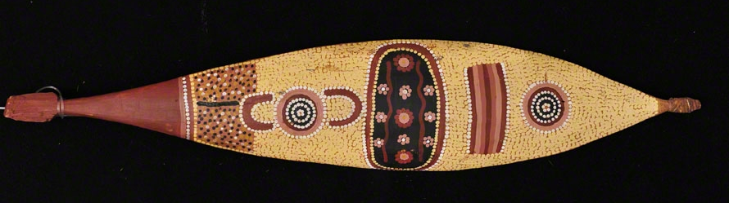
A multi-purpose tool!
Many examples of spear-throwers are elaborately decorated indicating their cultural significance. Spear-throwers from central Australia were light-weight and easily portable and designed to be used as a multipurpose tool.
The spear-thrower could be useful as a shield, and could also be used as a fire saw, a digging stick, a receptacle for mixing ochre, a carrying dish, or as a percussion device during ceremonies.
Some examples from central Australia have a sharp piece of rock embedded in the handle and held in place with spinifex resin. This enabled the spear-thrower to be also used as a tool for cutting, chiselling, shaping, and sharpening.

